Slide 1
Circuits and Code: FUN with Arduino!
Natalia Baklitskaya
Natalia.Baklitskaya@gmail.com

Slide 2
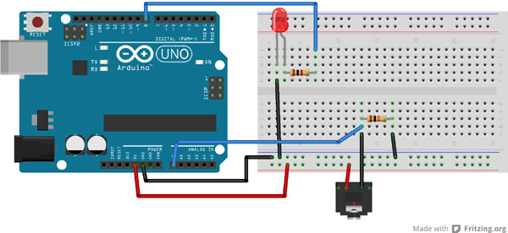
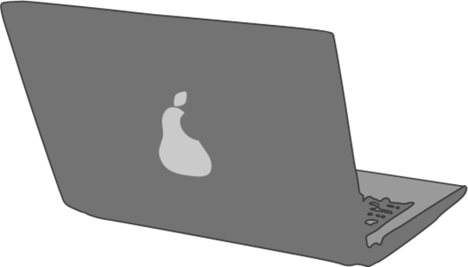
What is Arduino?
The heart (or the brain) of DIY projects
Microcontroller
A board with a chip that can be programmed to do many different things
Inputs (digital and analog)
Read input from sensors like ultrasonic sensor and thermistor
Outputs
Drive Circuitry

Slide 3
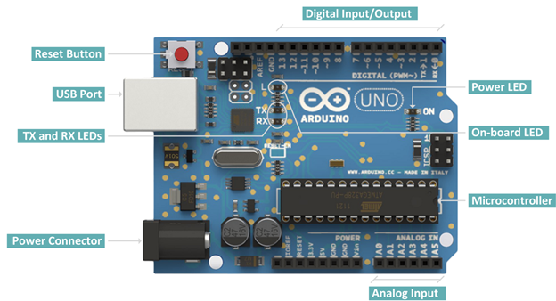
What is Arduino?
The heart (or the brain) of DIY projects

Slide 4

What Can I Build With Arduino?
http://www.instructables.com/id/20-Unbelievable-Arduino-Projects/

Slide 5
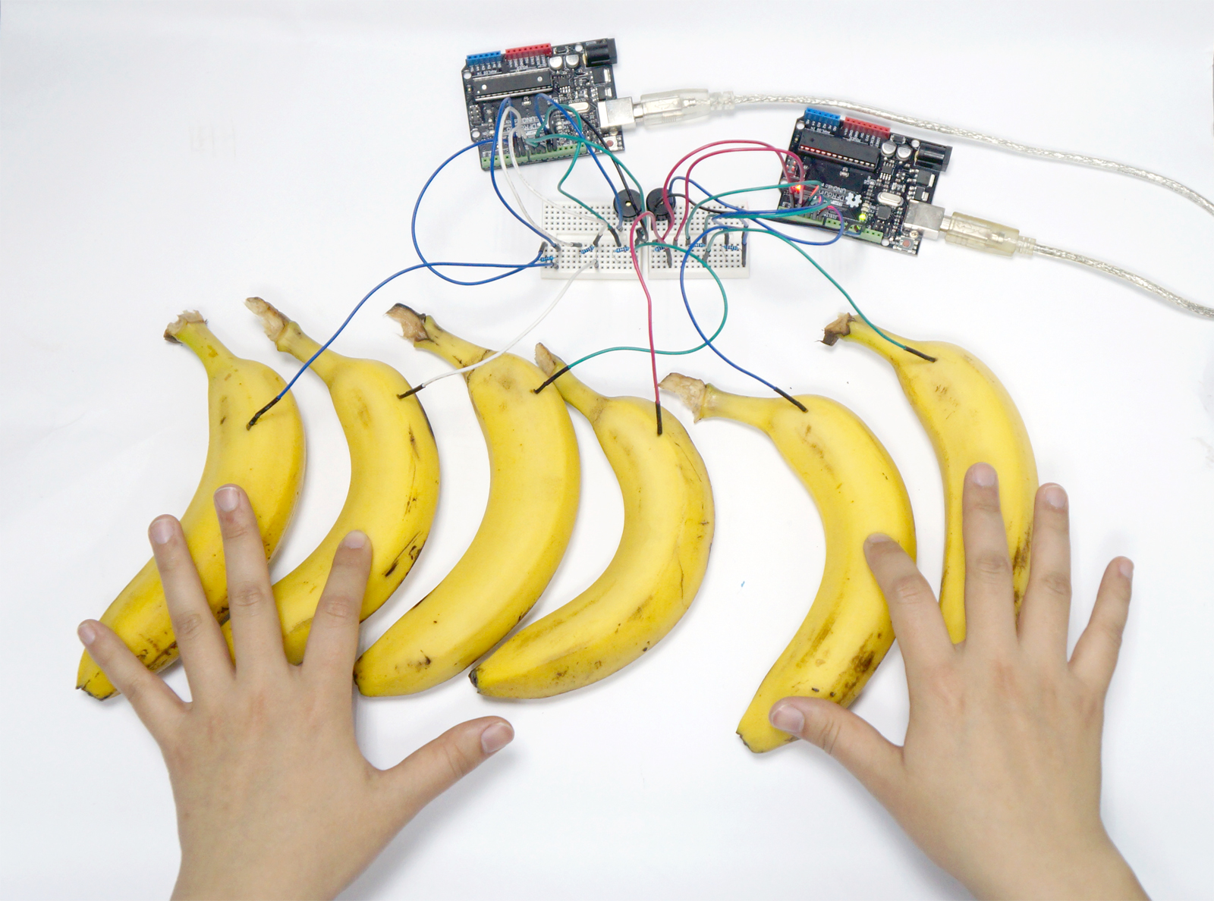
What Can I Build With Arduino?

Slide 6
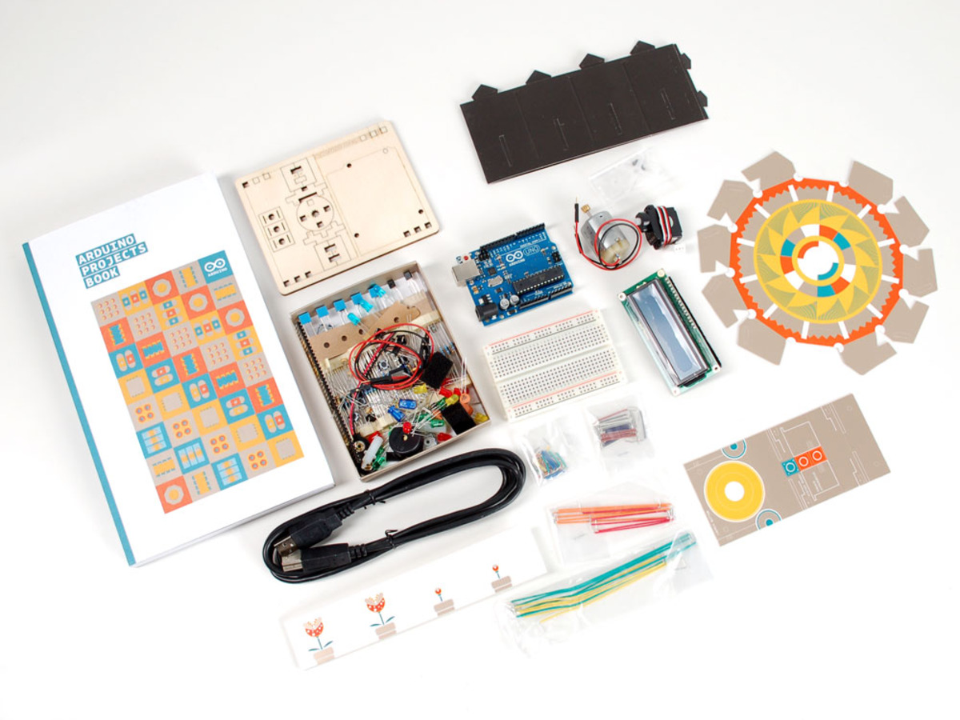
What are you working with?

Slide 7
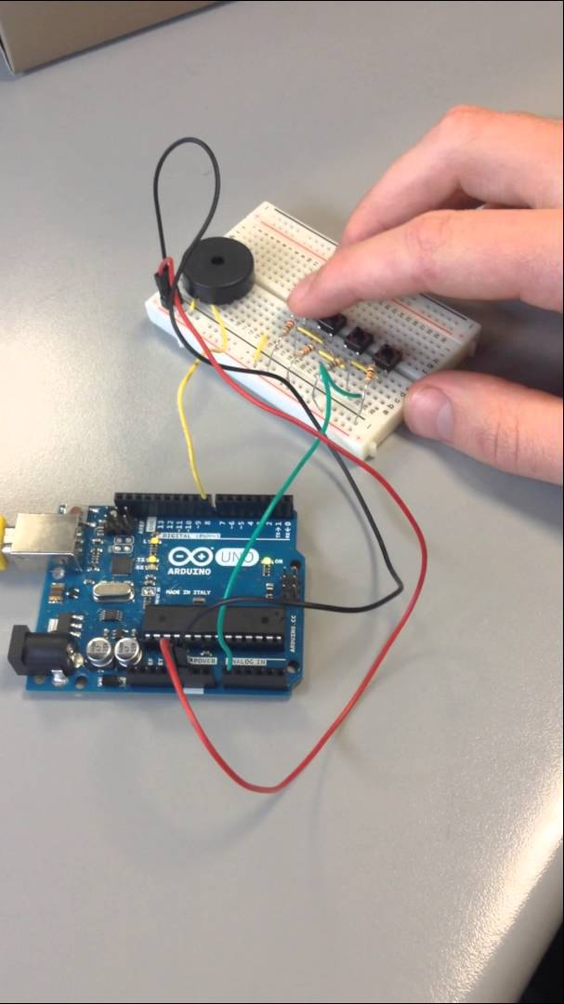
What Can I Build With Arduino?
Spaceship Interface
Love-O-Meter
Color Mixing Lamp
Mood Cue
Light Theremin
Keyboard Instrument
Digital Hourglass
Motorized Pinwheel
Zoetrope
Crystal Ball
Knock Lock
Touchy-feely Lamp

Slide 8
Who are you working with?
Groups
Teaching Assistants!

Slide 9
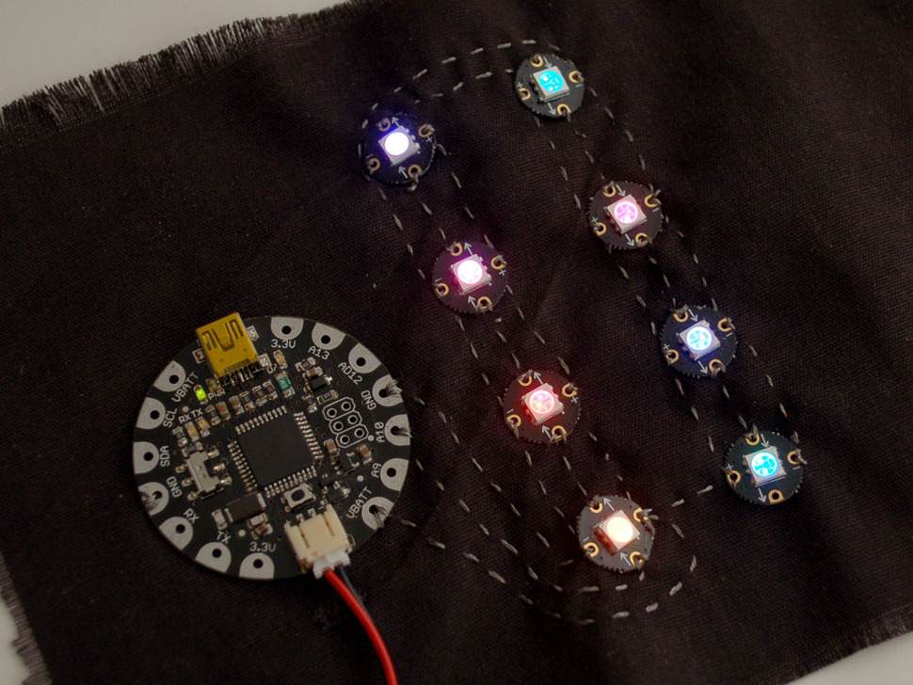
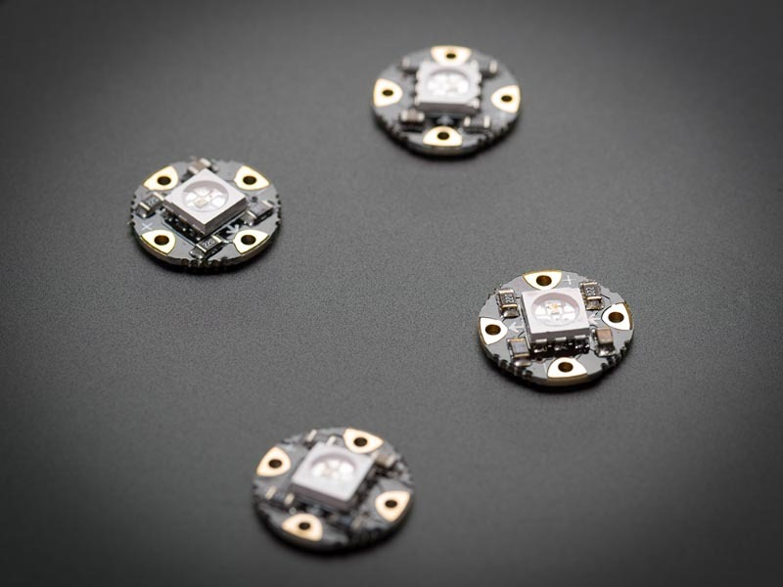
NeoPixels for Makers!

Slide 10
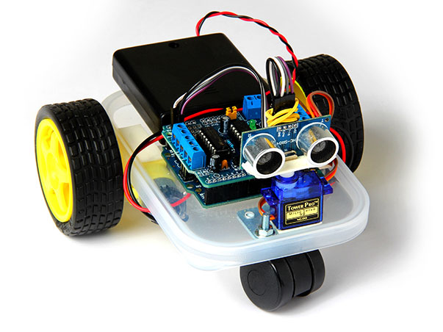
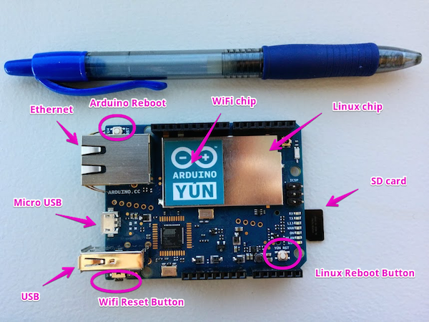
But what about Robots and IoT?
“..Once you’ve finished this tutorial, you may want to put your newly acquired skills to use by:
Building an Arduino Yun powered photo booth
Sending SMS and MMS from your Arduino Yun
Teaching your dog to send you selfies with the Arduino Yun “

Slide 11
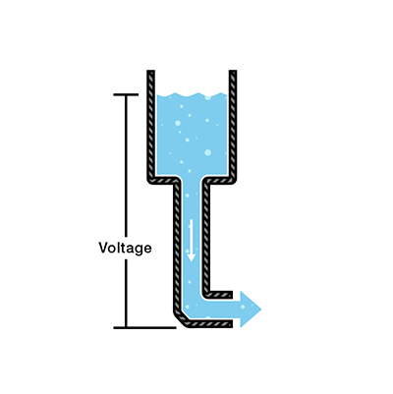
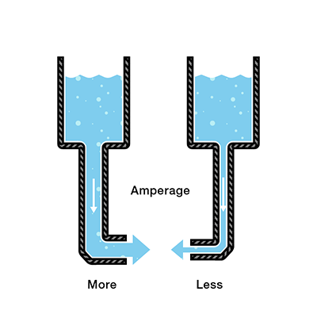
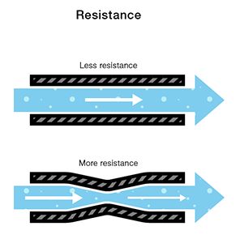
Voltage, Current, Resistance
Voltage is the difference in charge between two points.
Current is the rate at which charge is flowing.
Resistance is a material’s tendency to resist the flow of charge (current).
V = I * R

Slide 12
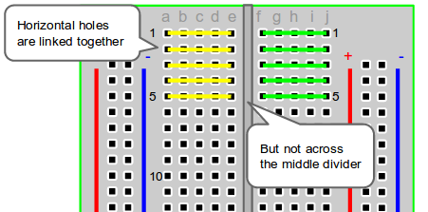
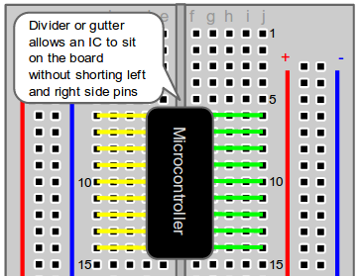
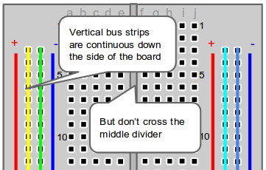
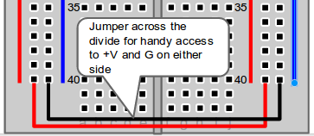
Breadboard Pins
http://computers.tutsplus.com/

Slide 13
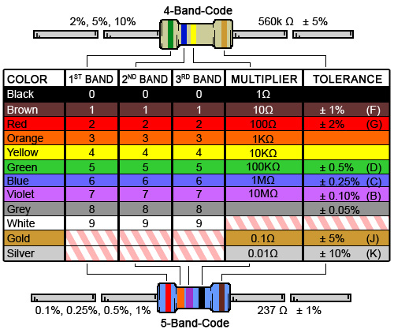
Resistor Color Codes

Slide 14
Digital Logic Levels + Analog Pins
OFF = 0 = 0 Volts
ON = 1 = 5 Volts
Analog pins have 1024 levels between 0 Volts and 5 Volts

Slide 15
Arduino Code: setup() and loop() Functions

Slide 16
Functions
Segmenting code into functions allows a programmer to create modular pieces of code that perform a defined task and then return to the area of code from which the function was "called".
The typical case for creating a function is when one needs to perform the same action multiple times in a program.
https://www.arduino.cc/en/Reference/FunctionDeclaration

Slide 17
Functions
Standardizing code fragments into functions has several advantages:
Functions help the programmer stay organized. Often this helps to conceptualize the program.
Functions codify one action in one place so that the function only has to be thought out and debugged once.
This also reduces chances for errors in modification, if the code needs to be changed.
Functions make the whole sketch smaller and more compact because sections of code are reused many times.
They make it easier to reuse code in other programs by making it more modular, and as a nice side effect, using functions also often makes the code more readable.
There are two required functions in an Arduino sketch, setup() and loop(). Other functions must be created outside the brackets of those two functions. As an example, we will create a simple function to multiply two numbers.
Try this example located in a folder on your Desktop: p02_SpaceshipInterfaceFunctions
https://www.arduino.cc/en/Reference/FunctionDeclaration

